Slide 1

ZEN HOTEL MANAGEMENT SYSTEM
"Zen Hotel Management – Where Operations Flow and Decisions Grow"

Slide 2
Zen Hotel Management System
Zen hotel Management streamlines hotel operations for efficiency and excellent service delivery.
It features two main user roles: Administrator and Receptionist.
Administrator Functions: Manage employee, room, and cab driver details and also ensure system security by logging out securely.
Receptionist Functions: Handle customer management, room availability, and transportation services as well as manage room status and customer transportation.
Zen Hotel Management ensures efficient hotel operations and a seamless experience for staff and guests.

Slide 3
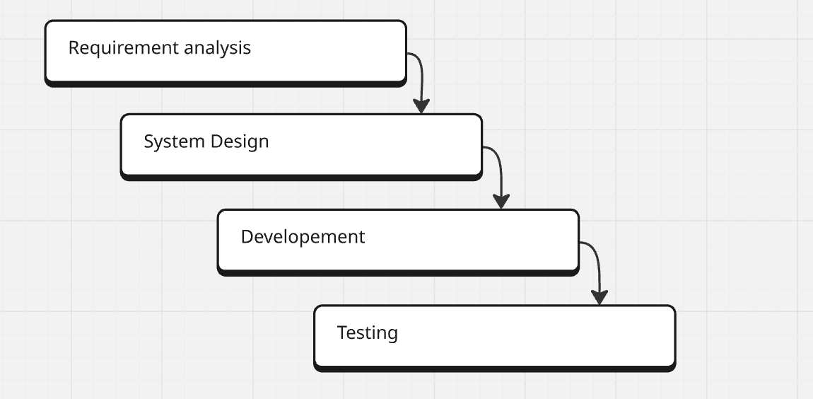
Implementation Stratergy

Slide 4



OUR TALENTED TEAM
Abhishek Khodade
Shaibaz Hasware
Yash Chutake
A tech-savvy innovator, driving seamless hotel operations with dedication.
Enhances guest experiences through technology and teamwork
Creative tech enthusiast, propelling our project forward.

Slide 5



Yash Kashid
Samiksha Shelke
Rushikesh Kolte
Efficient manager, leveraging technology and team support.
Tech expert, committed to
excellence and cooperation.
Strategic thinker, integrating tech solutions with hard work.

Slide 6
WORK CULTURE
Collaboration key to success
Supportive and inclusive culture
Open Communication
Transparent decision-making fosters trust.
Supportive and approachable leadership.
Constructive Feedback and recognition.
Positive and Inclusive Environment.
Team work and mutual support.

Slide 7
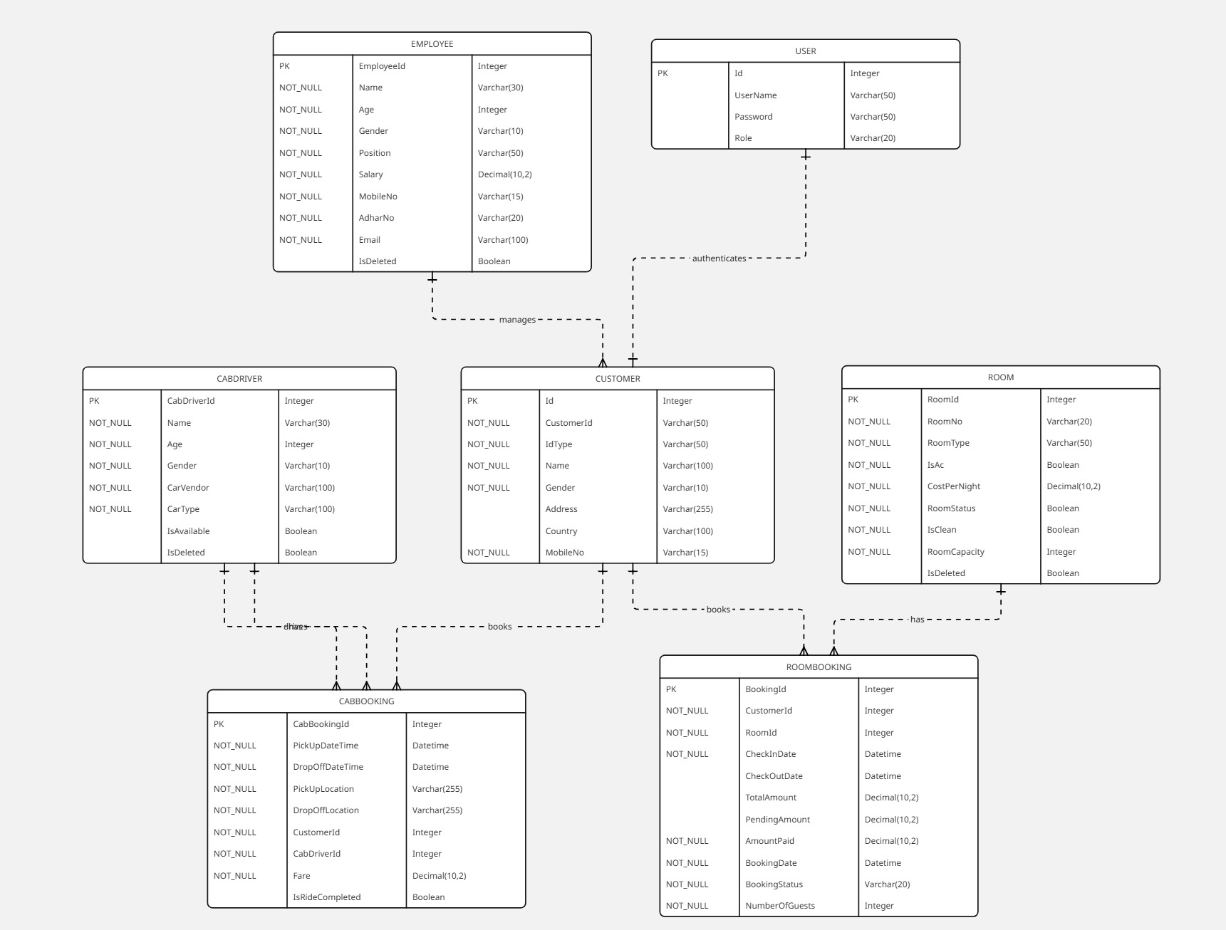
UML DIAGRAM:

Slide 8
Admin Roles & operations
User Permissions and access control determine what actions different users can take within system,ensuring data security and role based functionalities to maintain hotel integrity.
System Configuration options allow admins to manage platform to fit their unique operational needs,including settings for employees ,pricing stratergies and user management.

Slide 9
Receptionist roles & opertions
Check-in And Check-out Process:-
Check-in and Checkout processes streamlines customer arrival and departure,enhancing customer experience through efficient handling of booking,payments and room assignments.
Room Booking Management:-
Efficiently handles room reservations,ensuring optimal use of available rooms.Streamlines the booking process through management systems,enhancing overall customer satisfaction and operational efficiency.

Slide 10
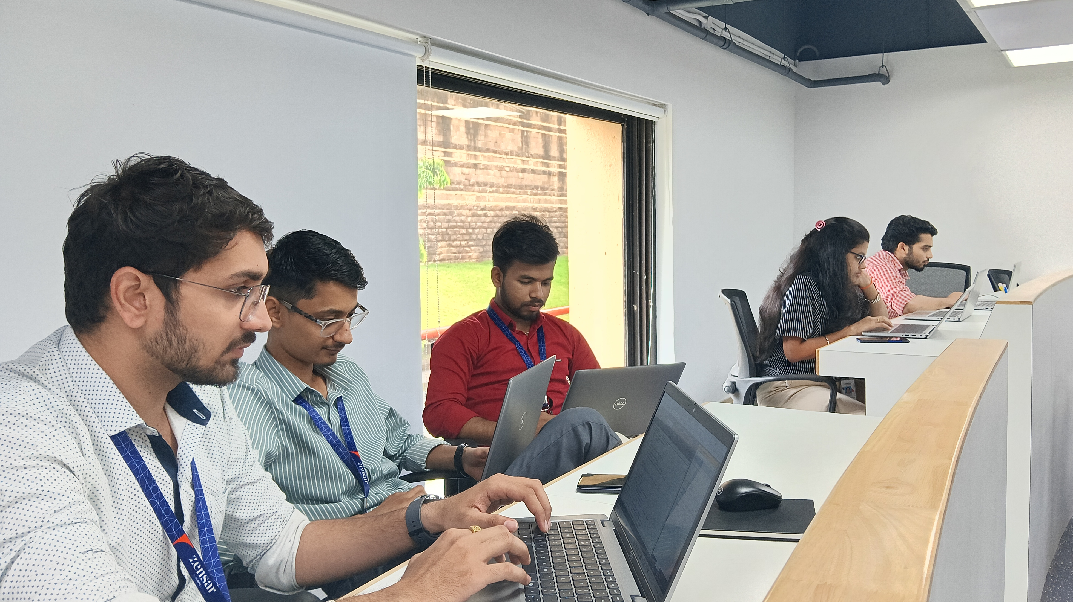
THANK YOU!!

